Slide 1
UNIT 15 – Object oriented programming
With ben read

Slide 2
Aims & objectives
Analyse the concepts of Constructors and Class Diagrams
Discuss class declaration and definition, default constructors, method and constructor overloading, and using the Unified Modelling Language
Review the week’s techniques via a self-paced tutorial

Slide 3
Initialisation
Initialising a variable
bool binary_choice = true;
Initialising an array
int random_ints[5] = {5, 141, 55312, 12, 100};
Initialising a structure
struct NPCData
{
char character_name[50];
eRace character_race;
int hitpoints;
};
NPCData boss = {“Tharg The Unclean”, eR_Troll, 6000};

Slide 4
Initialisation
Initialising a Class
class PlayerData
{
public:
char m_character_name[50];
eRace m_character_race;
int m_hitpoints;
bool m_indestructible;
char m_catchphrase[50];
char* getCatchphrase();
};
PlayerData player= {“John McClane”, eR_Human, 100, “Yippie Kie-Ay”, true };
PlayerData player= {“John McClane”, eR_Human, 100, true, “Yippie Kie-Ay” }

Slide 5
Initialisation
Initialising a Class
class PlayerData
{
public:
char m_character_name[50];
eRace m_character_race;
int m_hitpoints;
bool m_indestructible;
char m_catchphrase[50];
char* getCatchphrase();
};
NPCData player= {“John McClane”, eR_Human, 100, “Yippie Kie-Ay”, true };
NPCData player= {“John McClane”, eR_Human, 100, true, “Yippie Kie-Ay” }
All member variables are public and no constructor, so it Will Compile! (but don’t do this)

Slide 6
Initialisation
Initialising a Class
class PlayerData
{
public:
char m_character_name[50];
eRace m_character_race;
int m_hitpoints;
bool m_indestructible;
private:
char m_catchphrase[50];
public:
char* getCatchphrase();
};
PlayerData player = {“John McClane”, eR_Human, 100, “Yippie Kie-Ay”, true } ;
private:
PlayerData player = {“John McClane”, eR_Human, 100, “Yippie Kie-Ay”, true }
At least one member variable is private,
so this code Won’t Compile!

Slide 7
Initialisation
Initialising a Class
Use a special class method called a Constructor, which is used to configure an object and make ready for use.
e.g:
initialise member variables
call configuration methods
register itself with other classes/systems
etc, etc

Slide 8
Initialisation
Declaring a Class Constructor
class PlayerData
{
public:
char m_character_name[50];
eRace m_character_race;
int m_hitpoints;
bool m_indestructible;
private:
char m_catchphrase[50];
public:
PlayerData(void); //constructor
char* getCatchphrase();
};
PlayerData
PlayerData
NOTE:
Constructor method has same name as Class

Slide 9
Initialisation
Declaring a Class Constructor
class PlayerData
{
public:
char m_character_name[50];
eRace m_character_race;
int m_hitpoints;
bool m_indestructible;
private:
char m_catchphrase[50];
public:
PlayerData(void); //constructor
char* getCatchphrase();
};
(void)
Class Constructor method has NO RETURN VALUE – not even a void – but CAN take a parameter list.
a Constructor with an empty parameter list is known as the default constructor.

Slide 10
Initialisation
Defining a Class Constructor
PlayerData::PlayerData(void)
{
strncpy(m_character_name, “Nameless One”, 50); //TODO: const stringlength
m_character_race = eR_Human;
m_hitpoints = 100;
strncpy(m_catchphrase , “Who am I?”, 50); //TODO: const stringlength
m_indestructible = false;
};
PlayerData::PlayerData
NOTE:
Again , the Class Constructor method has NO RETURN VALUE – not even a void

Slide 11
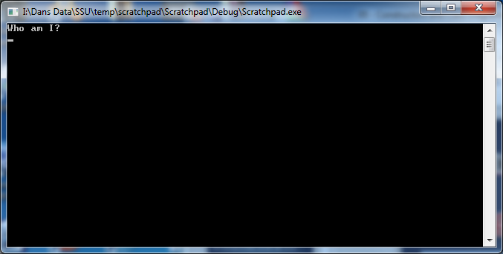
Initialisation
Using a Class with a Constructor
PlayerData player; //object created, default constructor called
//immediately and automatically.
cout << player.getCatchphrase() << endl;
cout << player.getCatchphrase() << endl
will output:

Slide 12
Constructors and Parameter Lists
Suppose we create an object but want to set some parameters to values OTHER than the default.

Slide 13
Constructors and Parameter Lists
Public member variables?
class PlayerData
{
public:
char m_character_name[50]
eRace m_character_race;
int m_hitpoints;
char m_catchphrase[50];
};
PlayerData player;
player.m_hitpoints = 10000;
public:
Public member variables
BAD !!!

Slide 14
Constructors and Parameter Lists
Accessor Functions?
class PlayerData
{
private:
int m_hitpoints;
char m_catchphrase[50];
public:
void setHitPoints(int points);
void setCatchphrase(char* phrase);
};
PlayerData player;
player.setHitPoints(10000);
player.setCatchphrase(“Leeeeroy! Jeeeenkins!”);
PlayerData fonz;
fonz.setHitPoints(5000);
fonz.setCatchphrase(“Eyyyyyyyyyy!”);
good coding practice for accessing member vars, but a laborious way to initialise an object.
void setHitPoints(int points);
void setCatchphrase(char* phrase);
setHitPoints
setCatchphrase
setHitPoints
setCatchprhase

Slide 15
Constructors and Parameter Lists
Constructor Parameter Lists!
class PlayerData
{
private:
int m_hitpoints;
char m_catchphrase[50];
public:
PlayerData(int points, char* phrase);
};
initialise as many (or all) of the member vars as required with data passed in via the parameter list
PlayerData(int points, char* phrase)
PlayerData::PlayerData(int points, char* phrase)
{
m_hitpoints = points;
strncpy_s(m_catchphrase, phrase, 50); //TODO: const stringlength!!! C’MON!!
}
PlayerData(int points, char* phrase)
//initialise object with custom data passed via constructor parameter list
PlayerData player( 10000, “Leeeeroy! Jeeeenkins!”);
PlayerData fonz( 5000, “Eyyyyyyyyyy!”);

Slide 16
Constructors and Parameter Lists
Class Constructor now rewritten to take parameters.
Now, every PlayerData object created MUST specify hitpoints and catchphrase.
BUT!
What if we DON’T WANT to have to specify hitpoints and catchphrase with every new PlayerData object?!

Slide 17
Object Oriented - Terminology
Method Overloading
several methods within a class with the same name but take different parameters in their parameter list.
Essentially allows one method to perform different tasks according to the data it is given.
Class MultiplyNumbers()
Data
Methods
int A
int B
float C
void InputVars(int, int)
void InputVars(int, float)
void InputVars(float float)
CLARIFICATION : Some O-O languages allow methods to be overloaded according to the method’s return type (e.g. int InputVars(int,int)and bool InputVars(int,int)) C++ isn’t one of them.

Slide 18
Constructor Overloading
class PlayerData
{
private:
int m_hitpoints;
char m_catchphrase[50];
public:
PlayerData(void); //default constructor
PlayerData(int points, char* phrase); //overloaded constructor
char* getCatchphrase();
};
PlayerData(void)
PlayerData(int points, char* phrase)
PlayerData::PlayerData()
{
//no parameters – set some defaults
m_hitpoints = 100;
strncpy_s(m_catchphrase, “Who Am I?”, 50);
}
PlayerData::PlayerData(int points, char* phrase)
{
//values supplied, so use them
m_hitpoints = points;
strncpy_s(m_catchphrase, phrase, 50);
}
PlayerData(void)
PlayerData(int points, char* phrase)

Slide 19
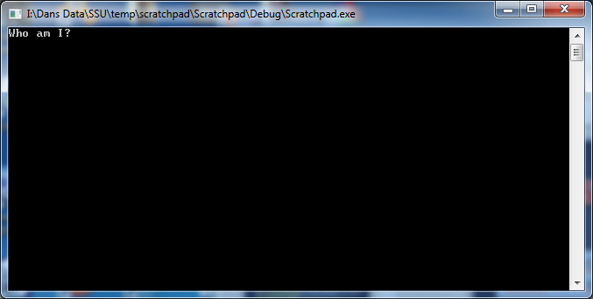
Constructor Overloading
PlayerData namelessOne; //no parameters, uses default parameter
cout << namelessOne.getCatchphrase() << endl;
PlayerData namelessOne;
will output:

Slide 20
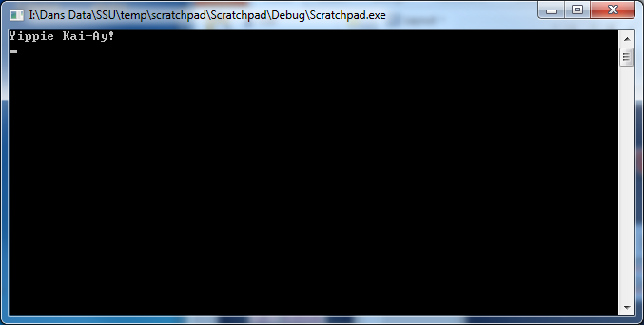
Constructor Overloading
//parameters passed, so uses overloaded constructor
PlayerData mcClane(10000, “Yippie Kai-Ay!”);
cout << mcClane.getCatchphrase() << endl;
PlayerData mcClane(10000, “Yippie Kai-Ay!”);
will output:

Slide 21
Rules of Constructors
when creating object using default constructor (no parameters), do NOT use brackets:
Won’t compile
MyClass dansClass();
()
when overloading, no parameters of same type in same order for different overloads:
(int varA, float varB)
Won’t compile, even though parameters names are different
MyClass(int varA, float varB);
MyClass(int varC, float varD);
(int varC, float varD)
(int varA, float varB)
this is allowed because the parameters are in a different order
MyClass(int varA, float varB);
MyClass(int varC, float varD);
(float varC, int varD)

Slide 22
Designing Classes
The Class Diagram
(Using UML – Unified Modelling Language)
PlayerData
+ m_character_name : char[50]
+ m_character_race : eRace
+ m_hitpoints: int
+ m_indestructible: bool
m_catchphrase: char[50]
+ PlayerData(void)
+ PlayerData(int points, char* phrase)
+ getCatchphrase() : char*

Slide 23
Designing Classes
The Class Diagram
(Using UML – Unified Modelling Language)
PlayerData
Class Name
+ m_character_name : char[50]
+ m_character_race : eRace
+ m_hitpoints: int
+ m_indestructible: bool
m_catchphrase: char[50]
Attributes
+ PlayerData(void)
+ PlayerData(int points, char* phrase)
+ getCatchphrase() : char*
Methods

Slide 24
Designing Classes
The Class Diagram
(Using UML – Unified Modelling Language)
PlayerData
+ means public
+ m_character_name : char[50]
+ m_character_race : eRace
+ m_hitpoints: int
+ m_indestructible: bool
m_catchphrase: char[50]
+
+
+
+
- means private
-
+ PlayerData(void)
+ PlayerData(int points, char* phrase)
+ getCatchphrase() : char*
+
+
+

Slide 25
Designing Classes
Defining Attributes
PlayerData
attributename first...
+ m_character_name : char[50]
+ m_character_race : eRace
+ m_hitpoints: int
+ m_indestructible: bool
m_catchphrase: char[50]
m_character_name
+ PlayerData(void)
+ PlayerData(int points, char* phrase)
+ getCatchphrase() : char*

Slide 26
Designing Classes
Defining Attributes
PlayerData
then datatype
+ m_character_name : char[50]
+ m_character_race : eRace
+ m_hitpoints: int
+ m_indestructible: bool
m_catchphrase: char[50]
char[50]
+ PlayerData(void)
+ PlayerData(int points, char* phrase)
+ getCatchphrase() : char*

Slide 27
Designing Classes
Defining Methods
PlayerData
+ m_character_name : char[50]
+ m_character_race : eRace
+ m_hitpoints: int
+ m_indestructible: bool
m_catchphrase: char[50]
method name (+ param list ) first...
+ PlayerData(void)
+ PlayerData(int points, char* phrase)
+ getCatchphrase() : char*
getCatchphrase()

Slide 28
Designing Classes
Defining Methods
PlayerData
+ m_character_name : char[50]
+ m_character_race : eRace
+ m_hitpoints: int
+ m_indestructible: bool
m_catchphrase: char[50]
then return value datatype
+ PlayerData(void)
+ PlayerData(int points, char* phrase)
+ getCatchphrase() : char*
char*

Slide 29
Designing Classes
Good Class Design Should:
Clearly identify variables
Clearly identify methods
Aid encapsulation and abstraction
Define an interface

Slide 30
Designing Classes
This is an example
BAD CLASS DESIGN:
attributes declared public
poor interface methods
Little support for encapsulation and abstraction
PlayerData
+ m_character_name : char[50]
+ m_character_race : eRace
+ m_hitpoints: int
+ m_indestructible: bool
m_catchphrase: char[50]
+ PlayerData(void)
+ PlayerData(int points, char* phrase)
+ getCatchphrase() : char*

Slide 31
Designing Classes
BETTER CLASS DESIGN
all attributes are private
Get/Set interface methods protect data access
designed with encapsulation and abstraction in mind
PlayerData
- m_character_name : char[50]
- m_character_race : eRace
- m_hitpoints: int
- m_indestructible: bool
m_catchphrase: char[50]
+ PlayerData(void)
+ PlayerData(int points, char* phrase)
+ getCatchphrase(void) : char*
+ getRace(void) : eRace
+ setIndestructible(bool)
+ getIndestructible(void) : bool

Slide 32
Designing Classes
By defining interfaces, data setting can be controlled:
void PlayerData::setIndestructible(bool isIndestructible)
{
if (isIndestructible)
{
//check rules for being indestructible
if ( m_hitpoints <= 0)
{
//can’t be indestructible if we’re dead...
return;
}
else if ( m_race == eR_human && !m_isJohnMcClane)
{
//can’t be indestructible if we’re human,
//(unless we’re John McClane)
return;
}
}
//got here? Indestructible setting is good
m_indestructible = isIndestructible;
}

Slide 33
Tutorial 04
Constructors
and
Class Diagrams

